Slide 1

Data Profession Basics and Data Science

Slide 2
What is the Data Profession?

Slide 3
Data Profession
A field in which practitioners collect, store, manage, and interpret data as their primary or relevant part of their activity.

Slide 4
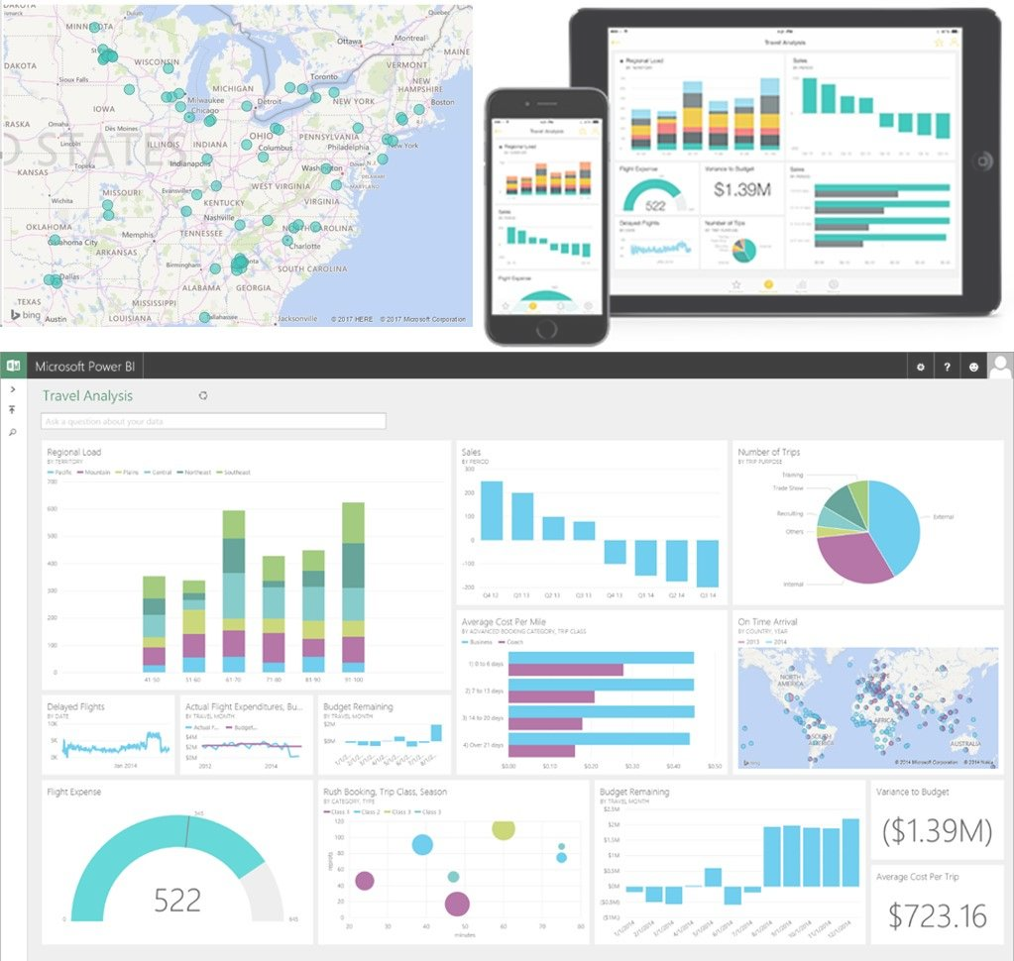

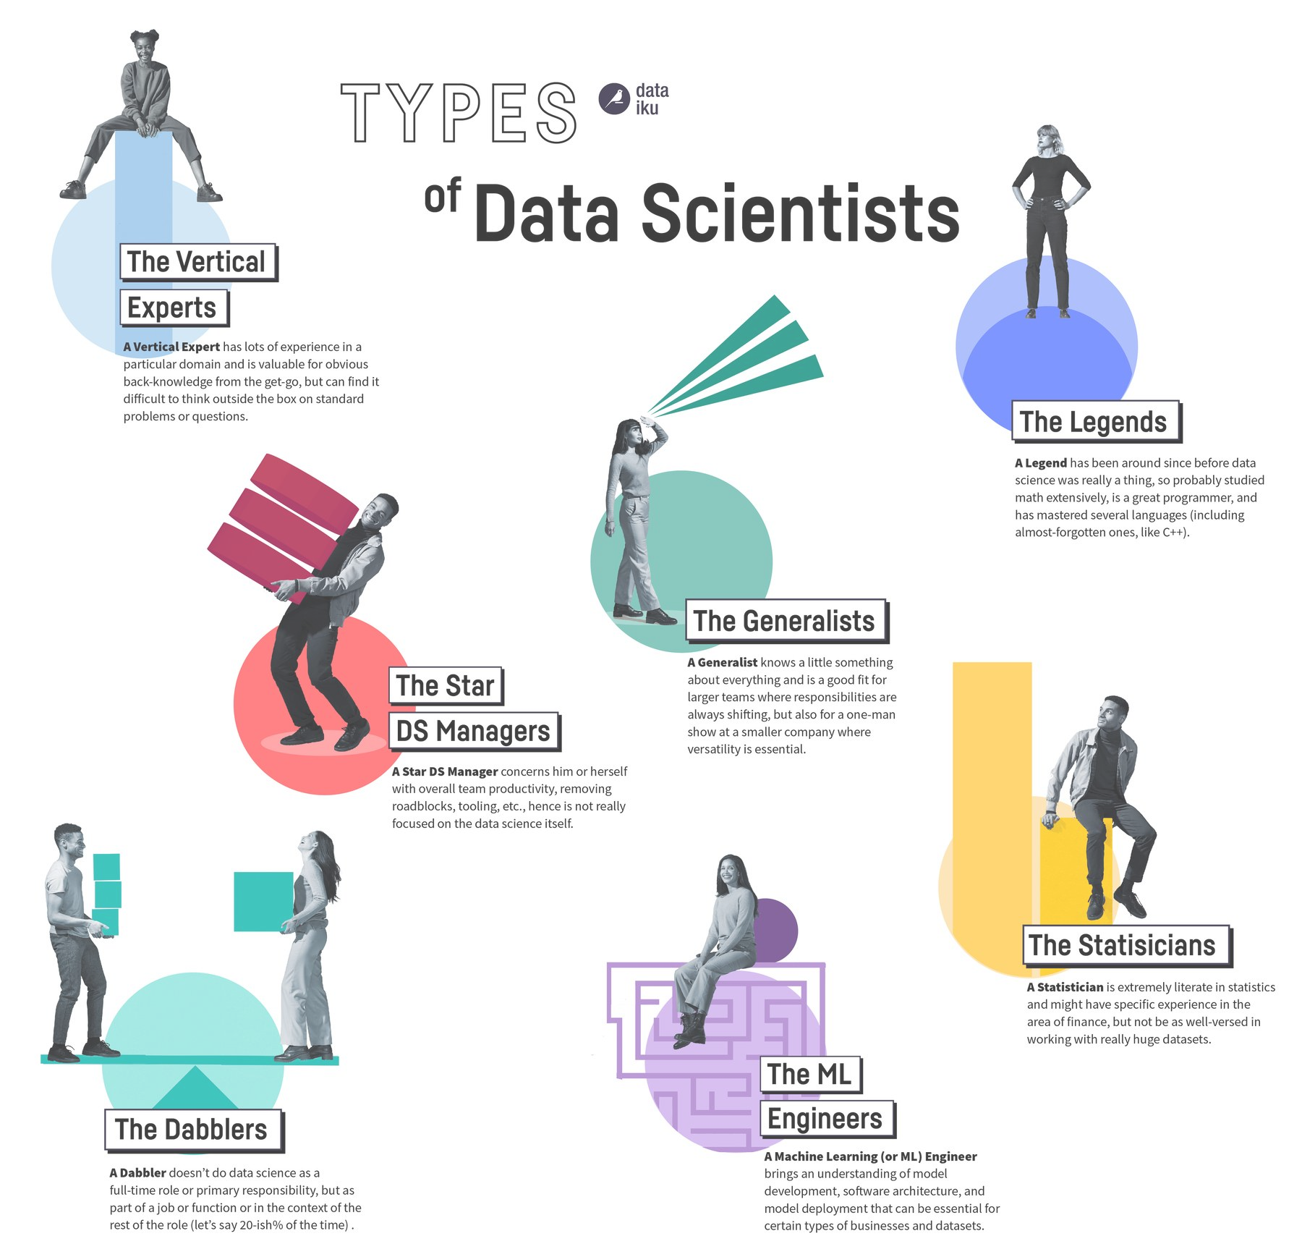
Data Profession Fields
Data Analyst
Data Engineer
Data Scientist
Transform data into actionable insights using dashboards and reporting tools.
Builds and maintains the infrastructure for data generation and storage.
Utilize algorithms, predictive models, and machine learning to analyze complex data.

Slide 5

Mission Need
“…we must value data as a strategic asset and view it as a force multiplier. We must make Air Force data visible, accessible, understandable, linked, and trusted which permits it to be used to enable mission execution in this quickly changing, demanding environment.”
–Air Force Chief Data Office, March 2019

Slide 6
From Vision to Action: Data & AI Today
2022 — DoD stands up the Chief Digital & Artificial Intelligence Office (CDAO), unifying data and AI leadership
2023 — DoD's Data, Analytics & AI Adoption Strategy turns the 2019 vision into direction
Nationally — America's AI Action Plan and the National Security Strategy make data & AI a top priority (see course handouts)
For you — data & AI fluency is now a baseline skill across the force, not a niche specialty

Slide 7
Data Analyst
Interpret data and turn it into actionable insights.
Use statistical tools to identify, analyze, and recognize patterns and trends.
Prepare reports and visualizations to communicate findings to stakeholders.
Collaborate closely with other departments such as marketing, finance, and operations.

Slide 8
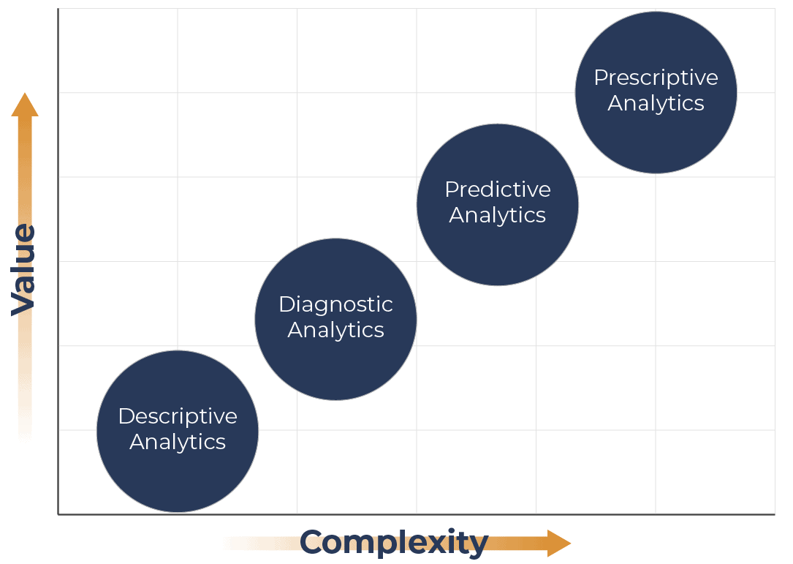

Slide 9
Data Engineer
Design, construct, and maintain large-scale processing systems.
Ensure the architecture supports the requirements of data practitioners.
Focus on optimizing data pipelines and workflows for efficiency and reliability.
Maintain data integrity, security, and accessibility.

Slide 10
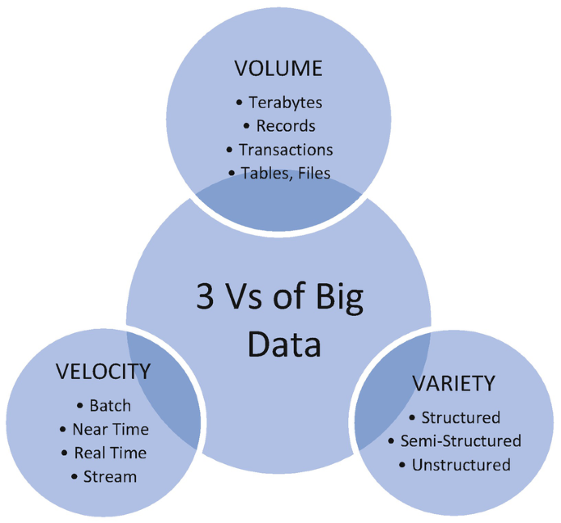

Slide 11
Data Scientist
Analyze and interpret complex data to help companies make informed decisions.
Use statistical methods, algorithms, and machine learning to uncover trends and patterns.
Work closely with stakeholders to understand business needs and provide data-driven solutions.

Slide 12
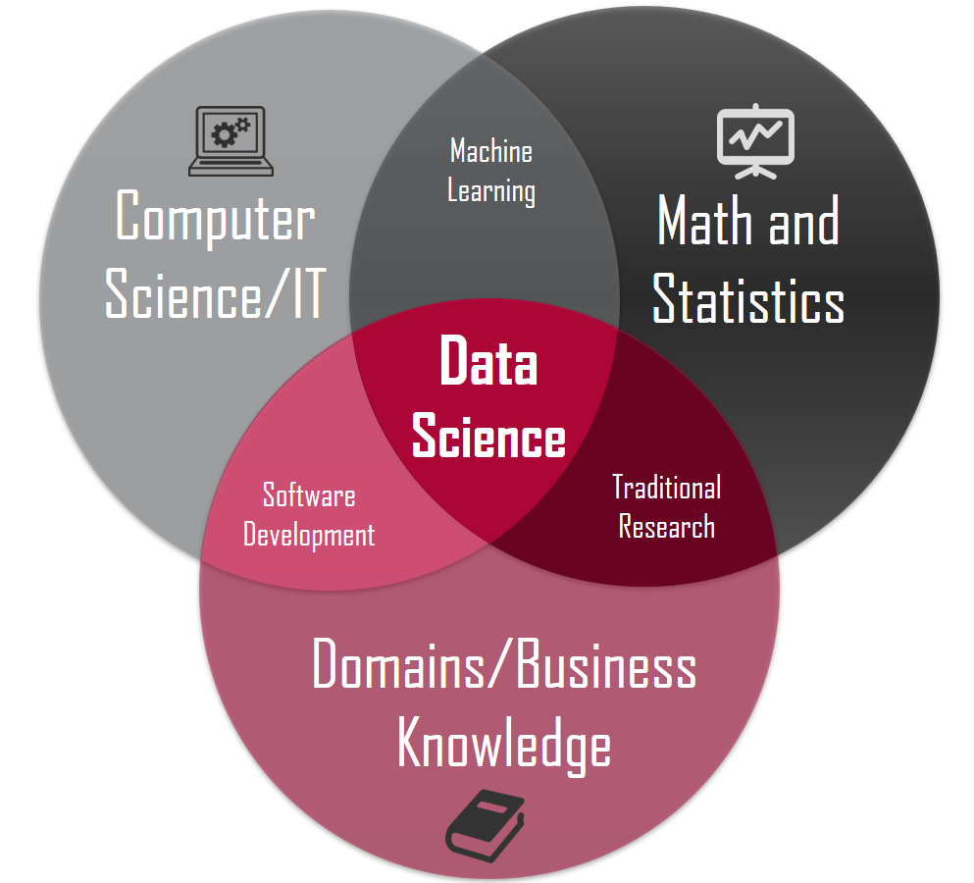

Slide 13





History of Data Science
1980s
1990s
2000s
2010s
2020s
Rise of Databases
Emergence of Data Mining
Big Data Era
Machine Learning and AI
Generative AI & LLMs
Notes:
1980s: Rise of Databases and Data Warehousing
Relational Databases: Introduction of relational database management systems (RDBMS) like Oracle, IBM DB2, and SQL Server.
1990s: Emergence of Data Mining (Pattern Recognition)
Data Mining Algorithms: Development of key algorithms like decision trees, clustering (e.g., K-means), and association rules (e.g., Apriori algorithm by Rakesh Agrawal).
2000s: Big Data Era
Large-Scale Data Support
Google's MapReduce: Introduction of the MapReduce programming model by Google, enabling large-scale data processing.
Apache Hadoop: Development of Hadoop, an open-source framework for distributed storage and processing of large data sets.
NoSQL Databases: Emergence of NoSQL databases (e.g., Cassandra, MongoDB) to handle unstructured and semi-structured data.
2010s: Machine Learning and AI
Data Science Breakthroughs: Deep Learning (CNNs and RNNs) and Rise of Data Science Platforms (Jupyter, Tensorflow, sci-kit learning)
2020s: Modern Data Science
Gen AI and Ethics: Race for Generative AI technologies/capabilities and increased tension for use and integration.

Slide 14
Applications of Data Science
Automate Satellite Image Analysis
Potential Threat Forecasting
Analyzing Unstructured Data with LLMs (e.g. Intel Reports)
Network Anomaly Detection
Notes:
Satellite Image Analysis: Detect changes in terrain, identify new construction activities, and monitor movement of vehicles and aircraft. By automating the analysis, we can reduce the time required to interpret vast amounts of satellite data, enabling quicker intelligence dissemination.
Predictive Analytics for Threat Assessment: Forecast potential threats based on historical data and current trends. For example, machine learning models analyze patterns of past air and space activities to predict future actions by adversaries. This allows anticipation and mitigation threats before they materialize.
Natural Language Processing (NLP): Process and analyze unstructured data from intelligence reports, news articles, and social media. NLP algorithms extract relevant information, identify key entities, and detect sentiment, providing analysts with insights into emerging threats and geopolitical developments.
Cyber Intelligence: Analyzing network traffic, identifying anomalies, and detecting patterns indicative of cyber-attacks to protect critical infrastructure and respond to cyber threats more effectively. Machine learning models help in identifying malware, phishing attempts, and other cyber threats in real-time.

Slide 15
Data Science Process
6
Model Deployment
1
Business Understanding
Project
Lifecycle
5
Model Evaluation
2
Data Preparation
6-steps
Iterative process
Continued maintenance and monitoring
Think OODA-loop
4
Data Modeling
3
Exploratory Data Analysis

Slide 16

1. Business Understanding
Define objectives
Scope of the project
Identify key metrics (KPIs)
Gather requirements
Notes:
Define Objectives:
Clearly articulate the business problem or research question.
Identify key stakeholders and their expectations.
Scope the Project:
Determine the scope and boundaries of the project.
Set realistic timelines and resource allocations.
Identify Key Metrics:
Establish success criteria and key performance indicators (KPIs).
Determine how success will be measured and monitored.

Slide 17
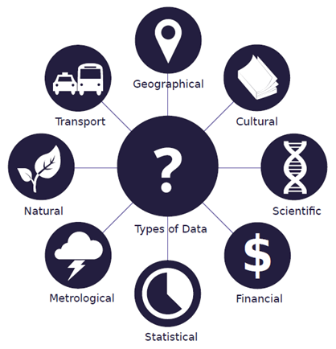
2. Data Preparation
~80%
Source, Clean, Transform, and Integrate
Notes:
Data Sourcing:
Determine relevant data sources (databases, APIs, web scraping, etc.).
Assess the availability and quality of data.
Data Cleaning:
Handle missing values, outliers, and inconsistencies.
Ensure data accuracy and completeness.
Data Transformation:
Converting data into a suitable format or structure for data analysis
Normalize and standardize data.

Slide 18
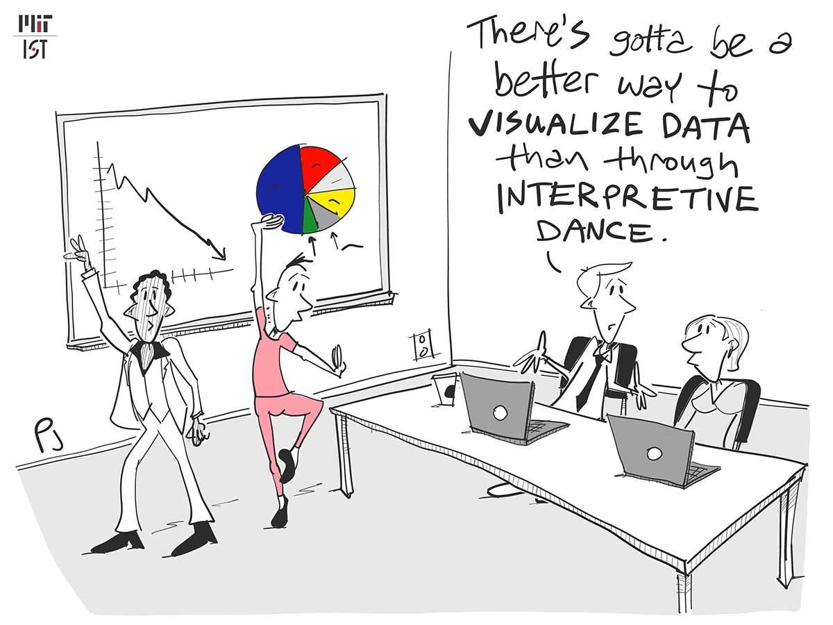
3. Exploratory Data Analysis (EDA)
Notes:
Descriptive Statistics:
Summarize data using mean, median, mode, standard deviation, etc.
Understand data distributions and central tendencies.
Data Visualization:
Create plots and charts to visualize data distributions and relationships.
Use histograms, scatter plots, box plots, etc., for insights.
Correlation Analysis:
Assess relationships between different variables.
Use correlation matrices and scatter plots to identify patterns.

Slide 19

4. Data Modeling
Machine learning algorithms
Model training
Parameter tuning
Feature Engineering
Notes:
Algorithm Selection:
Choose appropriate machine learning algorithms based on the problem.
Consider factors like model complexity, interpretability, and performance.
Model Training:
Train models on the prepared data.
Use cross-validation and other techniques to ensure robust training.
Parameter Tuning:
Optimize model parameters for better performance.
Use techniques like grid search, random search, or Bayesian optimization.

Slide 20
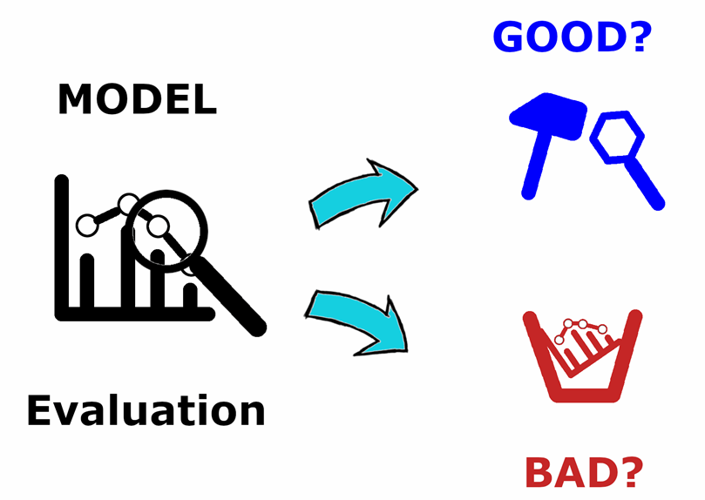
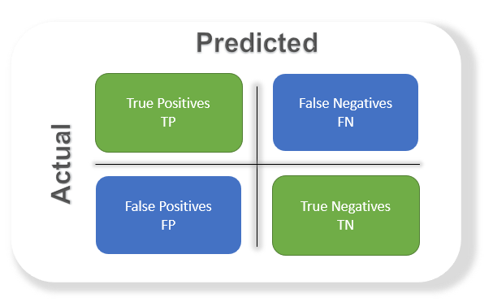
5. Model Evaluation
Notes:
Performance Metrics:
Evaluate models using metrics like accuracy, precision, recall, F1 score, etc.
Choose metrics that align with business objectives.
Compare Models:
Compare performance of different models and algorithms.
Select the best-performing model based on evaluation criteria.
Error Analysis:
Analyze model errors and identify areas for improvement.
Understand where and why the model is making incorrect predictions.

Slide 21



6. Model Deployment (MLOps)
Implementation
Monitoring
Maintenance
Deploy to production via automated pipelines (CI/CD)
Track key metrics and identify performance degradation.
Regularly update and retrain model with new data
Notes:
Implementation: Deploy model into production environment and integrate with existing systems
Monitoring: Continuously model performance in real world
Successful deployment requires collaboration between data scientists, engineers, and stakeholders to meet business goals and compliance requirements.

Slide 22
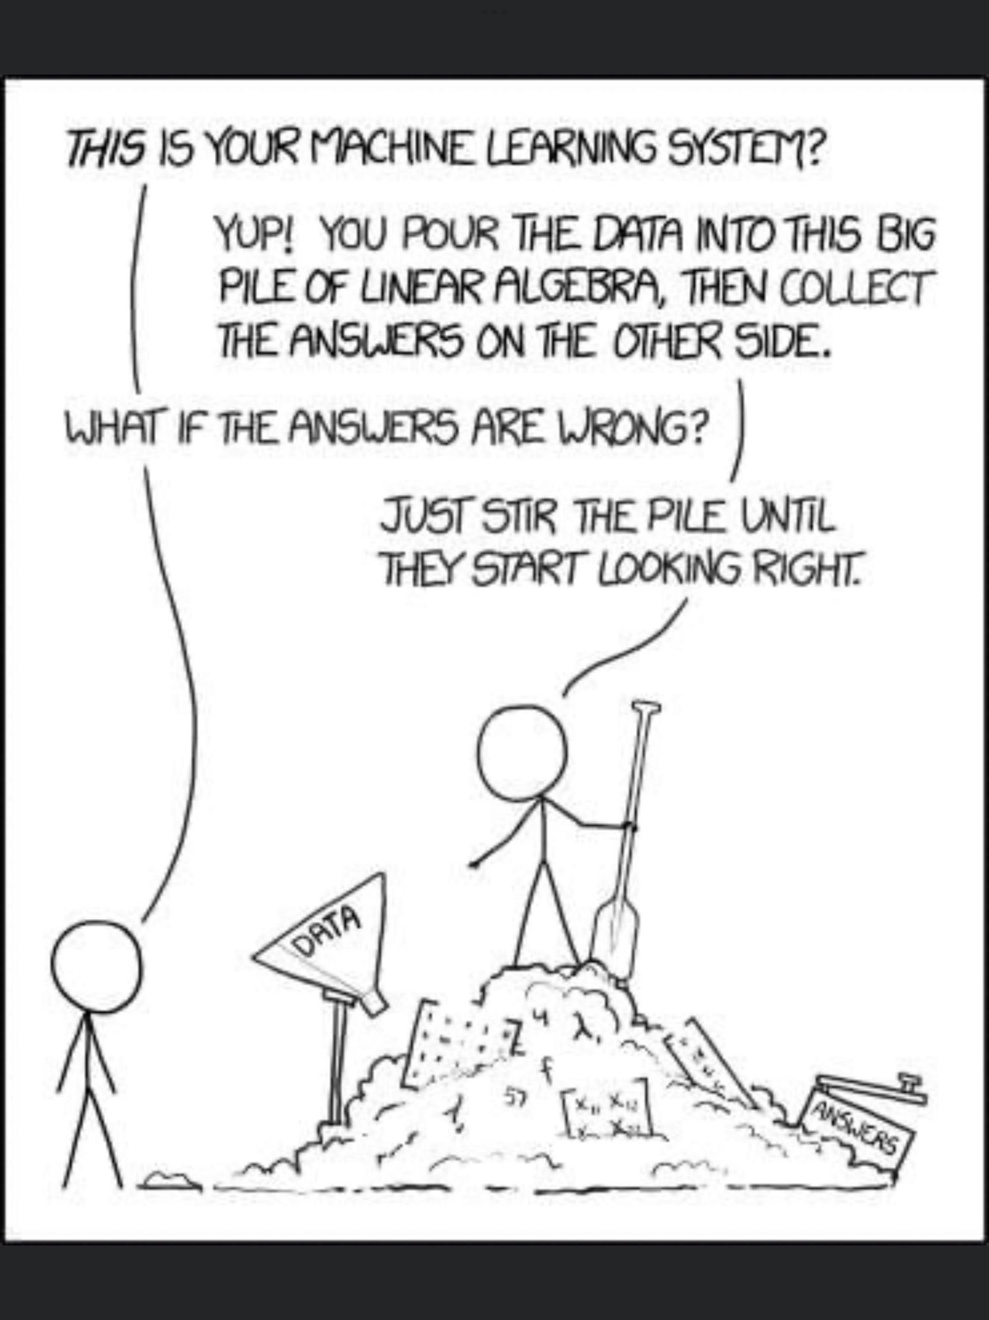

Slide 23

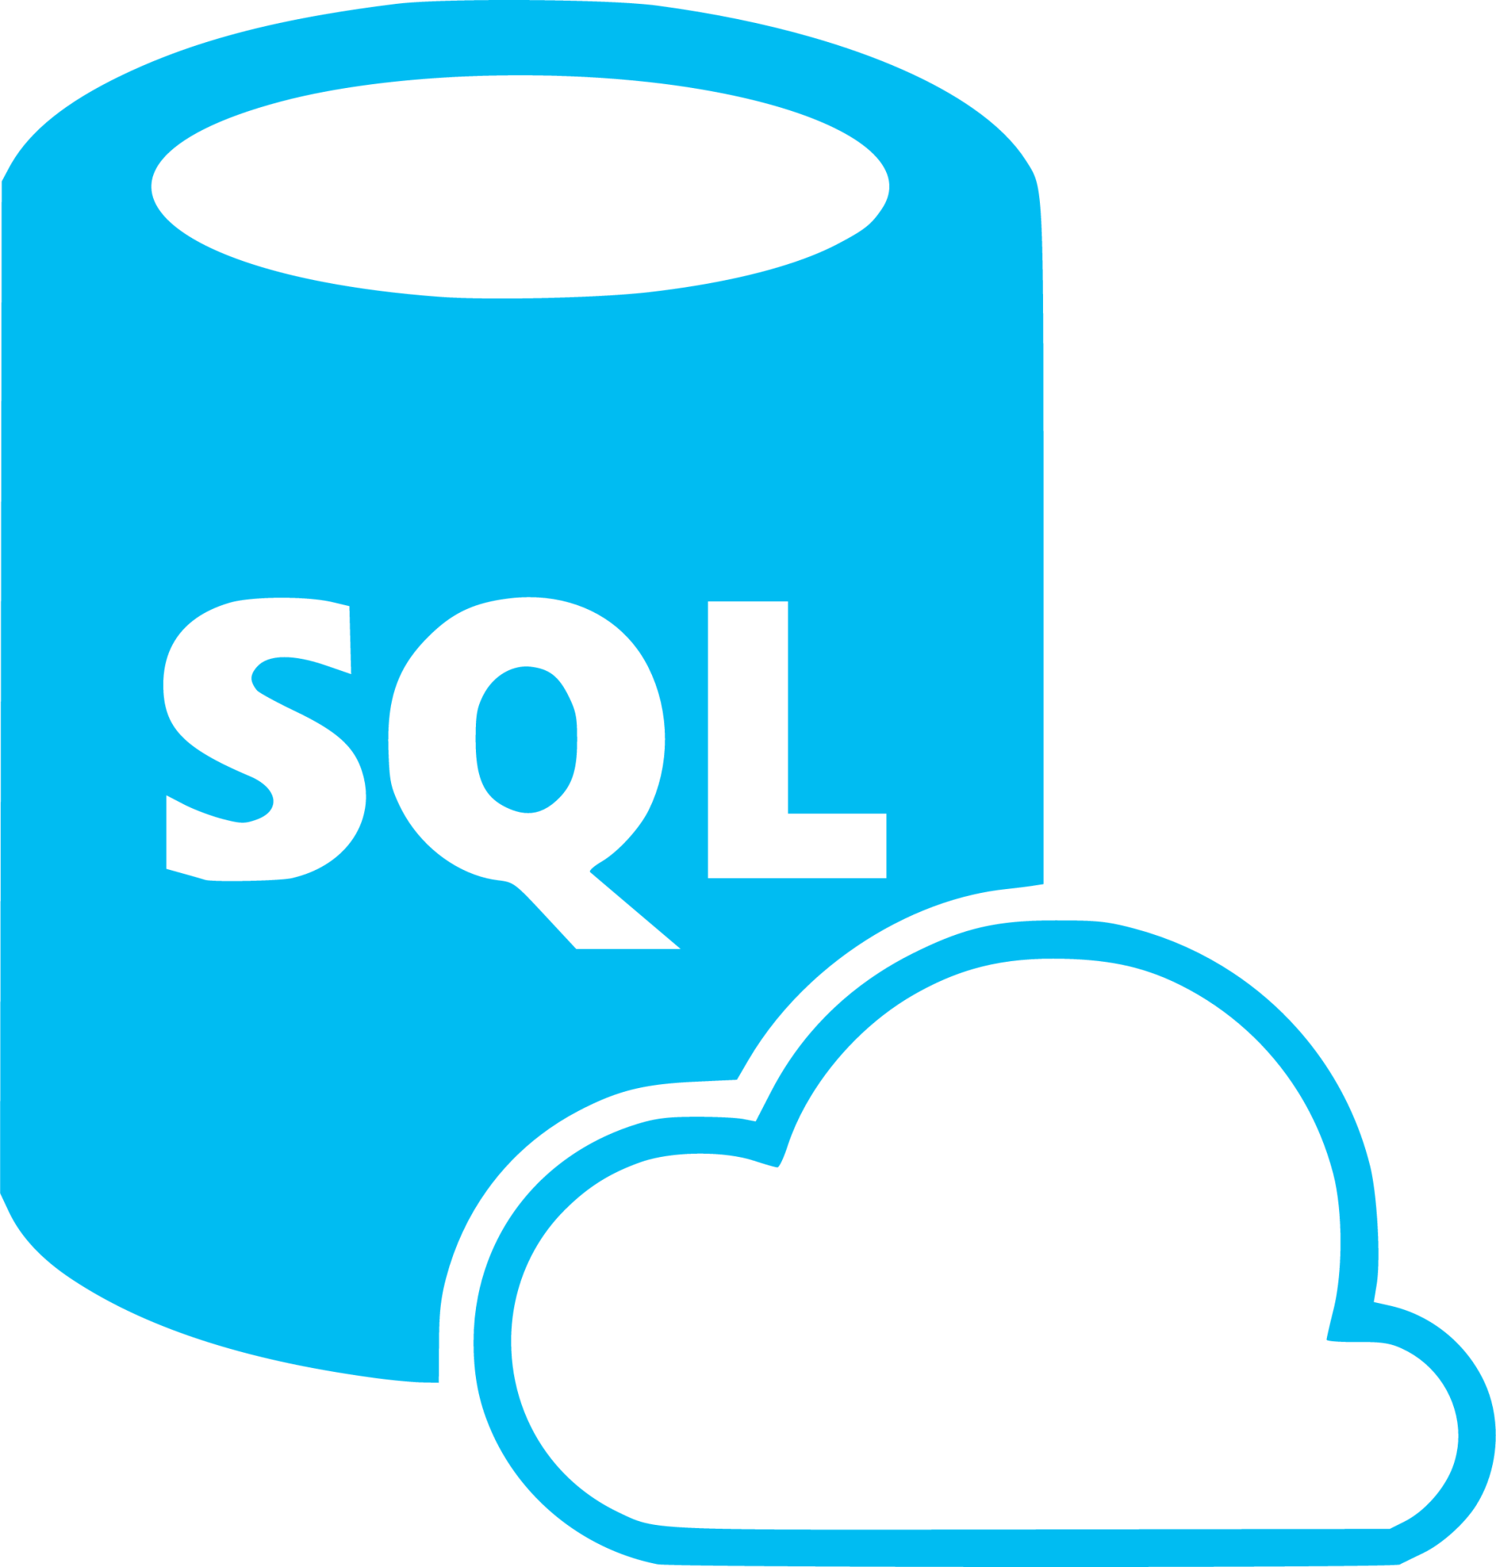


Data Science Tools

Slide 24
What is Python?

Slide 25




Python
A versatile programming language used for various applications:
Data Science
Web Development
Automation
Scripting
Requires an Integrated Development Environment (IDE).

Slide 26
Benefits of Python
Popularity and Community Support
Widespread use
Abundant resources, open-sourced
Rich ecosystem with specialized libraries
NumPy, Pandas, Matplotlib, Scikit-Learn etc.
Ease of Learning and Use
Simple syntax
Versatility

Slide 27
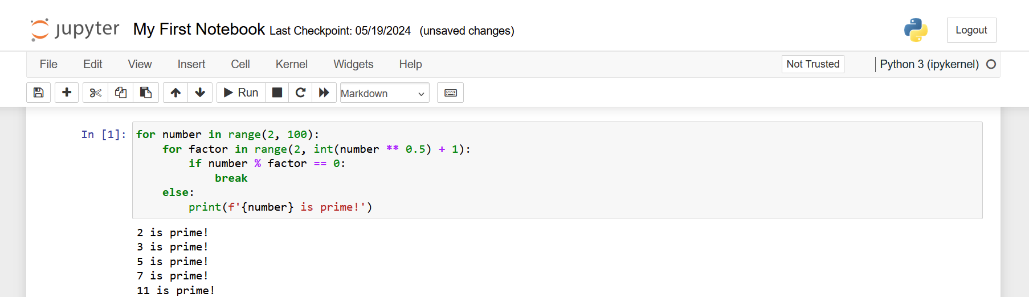
Jupyter Notebooks

Slide 28
How Python Sees Data
1-D — a list (my_list = ['a','b','c','d','e'])
values
a
b
c
d
e
index
0
1
2
3
4
Python counts from 0: data[0] → 'a' data[4] → 'e' (indexes 0–4)
2-D — rows × columns (a table / DataFrame); address a value with a[row][col]
col 0
col 1
col 2
a[1][1] = 4
row 0
12
7
3
→ row 1, column 1
row 1
9
4
8
shape = (3, 3)
3 rows × 3 columns
row 2
5
2
6

Slide 29
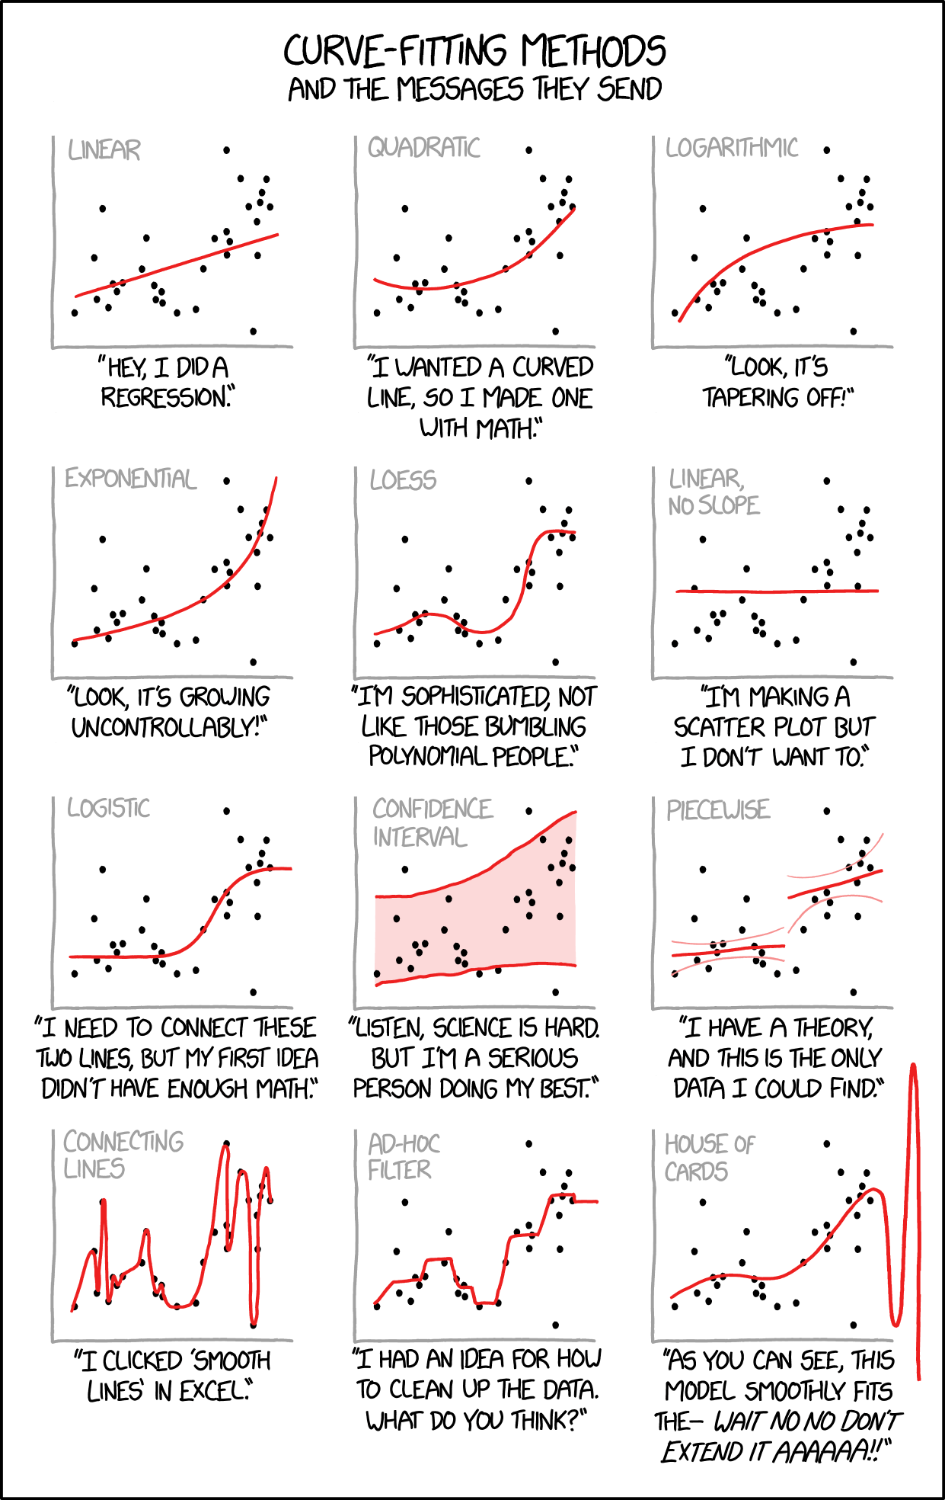
Questions?

Slide 30
Doing vs. Applying
Data science curriculums (USAFA, AFIT, etc.)
Provide technical aspect
Lack of development in domain knowledge
Trivial problems diminish skills
New field, unknown applications

Slide 31

Air Force Wide Data Literacy
Data education for everyone
Develop domain knowledge learning
Improve data collection capabilities
Identify problems that effectively apply analysts
Increasing communication

Slide 32
Conclusion
“To compete against great power adversaries, the Air Force must harness the power of this data revolution and develop the underlying structures to dominate a new and merging character of war.”
–Matthew Donovan, SAF/US
Effectively apply trained data analysts
Develop a culture that values, understands, and cultivates data

